Slide 1
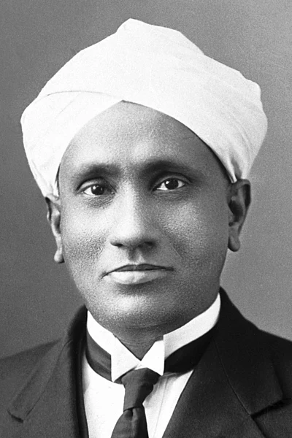
NSS WING OF BCRCP
Celebrates
National Science Day
Theme
“'Indigenous Technologies for
Viksit Bharat”
Highlight:
Online Quiz Competition
Registration link
28th February’24
NSS WING
Dr. B. C. Roy College of Pharmacy & AHS (BCRCP)
West Bengal, India

